Slide 1
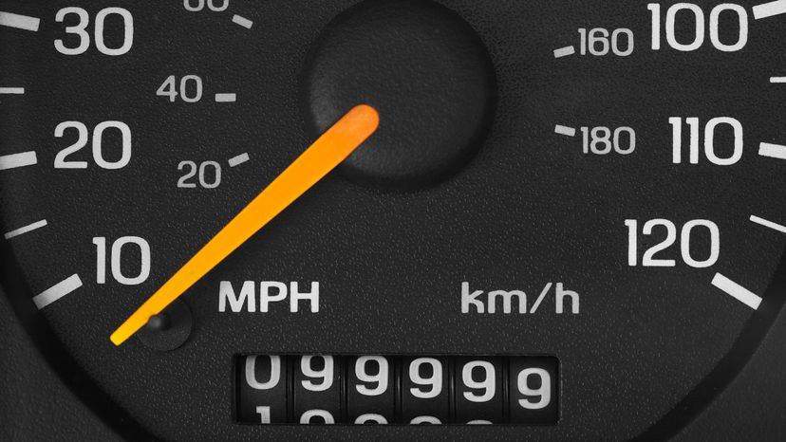
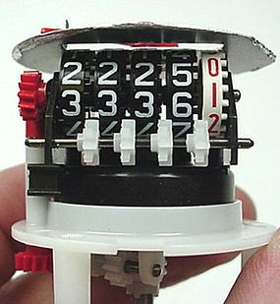
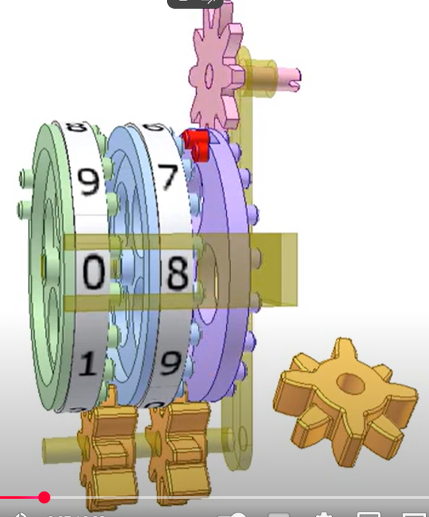
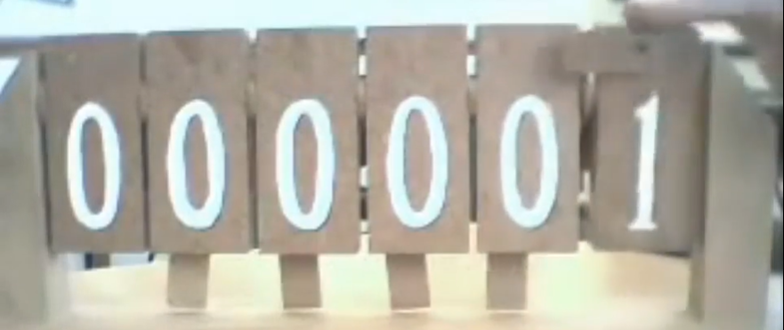
counting with
10 symbols
also known as
“decimal” counting
decade
decathlon
decahedron
deca (greek)
dieci (italian)
diez (spanish)
dix (french)
december (12 ? or 10 !! )
counting with
10 symbols / characters / digits
also known as
“decimal” counting
decade
decagon
decem (latin)
deca (greek)
dieci (italian)
diez (spanish)
dix (french)
december (is it 12 ? or 10 ?!)
why 10 ? people like counting with 10 symbols / digits
because we have 10 fingers (10 digits)
video of mechanical decimal counter
counting with
2 symbols
also known as
“binary” counting
bicycle
biped
bi
why 2 ? computers have various ways of representing individual values, each with only 2 possible states
voltage on wire high voltage / low voltage
electronic switch on / off
CD surface state hole / no hole
piece of magnetic tape magnetized / not magnetized
boolean value true / false
video of mechanical binary counter

Slide 2
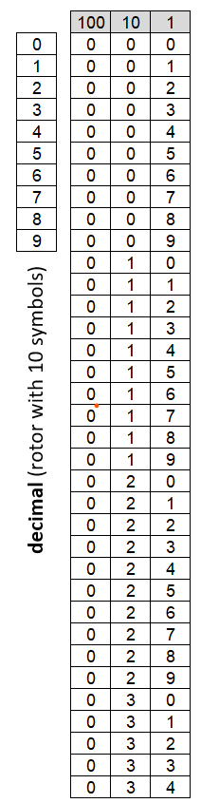
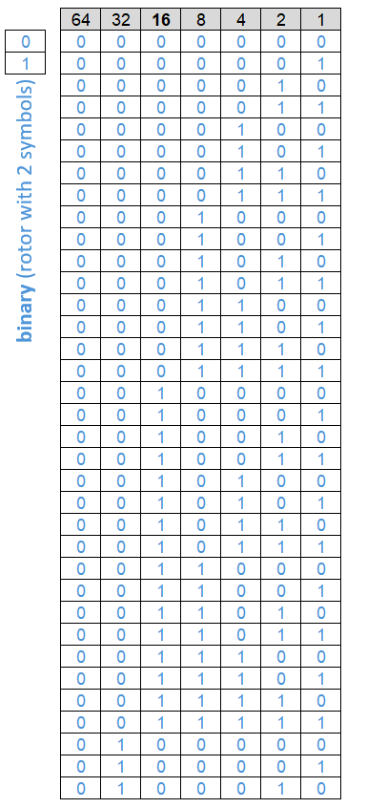
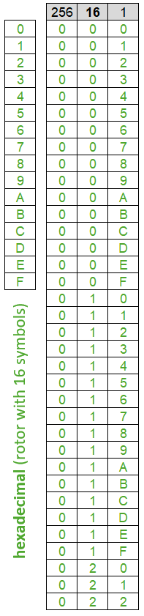
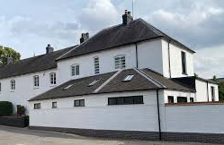

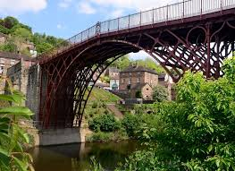
Start
p41. "Hexadecimal uses sixteen different digits."
It would be clearer to say :
"Hexadecimal uses sixteen different symbols."
bit : 1 blue
nibble : 1 green 4 blues
byte : 2 greens 8 blues
p42. "Each hex digit is equal to a nibble in binary"
It would be clearer to say :
"Each hex character represents four binary characters, also known as a nibble."
digit : 1 black (but this word isn't always used clearly)
The cycling distance from Beacon Croft to Ironbridge is :
32 miles (decimal) "thirty two miles"
100000 miles (binary) "binary one zero zero zero zero zero miles"
20 miles (hexadecimal) "hex two zero miles"
a given symbol in hexadecimal
does always line up with
the same symbols in binary
a given symbol in decimal
doesn't always line up with
the same symbols in binary
Finish

Slide 3
